Slide 1
Server Security Basics
Server & Cloud Security
1

Slide 2
Objectives
Server Roles
Server Attack Vectors
Defense-in-Depth
Disaster Recovery

Slide 3
Recall from OSNF Module
Two common network models:
Peer-to-Peer (no Server)
Client-Server (also known as Server-based)
In this model, there is at least one dedicated computer running a server network operating system (NOS) e.g. Windows Server 2019 that controls the level of user access to shared resources such as file storage, network printing and Internet access.

Slide 4
So, what is a Server?
A server is a computer program or a machine that waits for requests from other machines or software (clients) and responds to them.
A server typically processes data.
The purpose of a server is to share data or hardware and software resources among clients.
This architecture is called the client–server model.
The clients may run on the same computer or may connect to the server over a network.

Slide 5



Security is familiar
Confidentiality
Integrity
Availability
Limit access and disclosure to authorized users
Prevent access by unauthorized people
Maintain data consistency during its lifecycle
Preserve data at rest and data in transit
Have access to information resources when needed
Notes:
Security is the practice of protecting your intellectual property from unauthorized access, use, or modification. The triad of confidentiality, integrity, and availability, or CIA, was originally developed to highlight the important aspects of information security within an organization.
Confidentiality refers to limiting information access and disclosure to authorized users and preventing access by unauthorized people.
Integrity involves maintaining the consistency, accuracy, and trustworthiness of data over its entire lifecycle. This includes “origin” or “source integrity,” which is assurance that the sender of that information is who it is supposed to be. Integrity can mean ensuring that the person or entity in question entered the correct information. However, integrity of an information system might only mean preserving data without corruption of whatever was transmitted into or entered into the system.
Availability refers to the readiness of information resources. An information system that is not available when you need it is almost as useless as no information system. Modern day IT environments bring challenges to the CIA triad because of the volume of information that must be safeguarded, the multiplicity of sources that the data comes from, and the variety of formats.

Slide 6
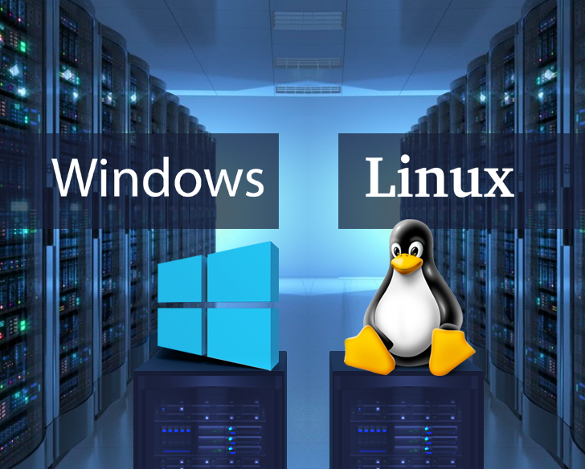
Server Roles

Slide 7
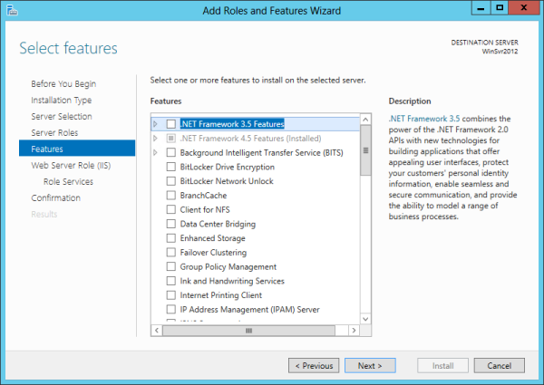
Server Roles
Servers are deployed to offer services that provide some kind of business value to an organization.
The installation, configuration, and management of server roles vary depending on the specific server OS version. The figure below shows the Add Roles And Features Wizard that is used to add roles to a Windows server.

Slide 8
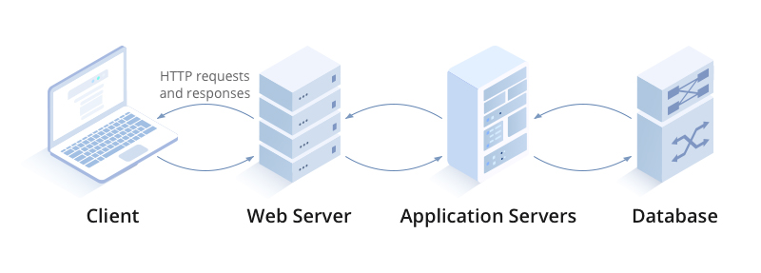
Common Windows Server Roles
Server Role | Purpose
Web Server | Web servers are used to provide access to information to users connecting to the server using a web browser, which is the client part of the application. A web server uses HTTP/HTTPS as its transfer mechanism.

Slide 9
Common Windows Server Roles
Server Role | Purpose
Application Server | An application server is one that users connect to and then run their applications on. In many cases this server is the middle tier in a three-tier architecture that accepts users’ requests to its application and then communicates with a database server where content is stored.

Slide 10
Common Windows Server Roles
Server Role | Purpose
Database Server | A database server is one that runs database software such as SQL Server or Oracle. It contains information stored in the database and users can search the database, either directly by issuing commands or by using an application that does this through a GUI.

Slide 11
Common Windows Server Roles
Server Role | Purpose
File Server | File servers are used to store files that can be accessed by the network users.
Network Services Server - DHCP | Dynamic Host Configuration Protocol (DHCP) servers are used to automate the process of providing an IP configuration to devices in the network. These servers respond to broadcast-based requests for a configuration by offering an IP address, subnet mask, and default gateway to the DHCP client.
Network Services Server - DNS | Domain Name System (DNS) servers resolve device and domain names (website names) to IP addresses, and vice versa.

Slide 12
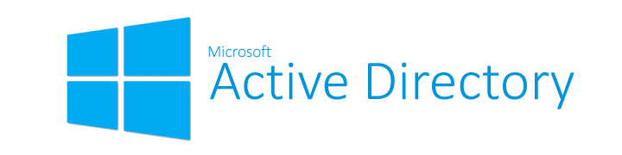
Common Windows Server Roles
Server Role | Purpose
Directory Services Server | A directory services server is one that accepts and verifies the credentials of users. One of the best examples is the Active Directory Domain Services (AD DS). AD DS acts as the core directory service for an organization, managing hierarchical relationships between network objects (users, systems, servers, applications etc.).

Slide 13

Server Attack Vectors

Slide 14
Compromised / Weak Credentials
Usernames and passwords are the most common type of access credential and continue to be exposed in data leaks, phishing scams, and malware. When lost, stolen, or exposed, credentials give attackers unfettered access.
Organizations use password managers, two-factor authentication (2FA), multi-factor authentication (MFA), and biometrics to reduce the risk of leak credentials resulting in a security incidents.
(More details on User rights, password policies and account lockout policies will be covered in Week 2)

Slide 15
Poor Encryption
‍Common data encryption methods like SSL certificates can prevent man-in-the-middle attacks and protect the confidentiality of data being transmitted.
To mitigate it, the organization should have strong encryption for both data-at-rest and data-in-transit.
(More details will be covered in Week 2 and Week 6)

Slide 16
DoS / DDoS Attack
Denial-of-service (DoS) attacks are attacks that prevent a system from processing or responding to legitimate traffic or requests for resources and objects.
A common form of a DoS attack will transmit so many data packets to a server that it cannot process them all.
Other forms of DoS attacks focus on the exploitation of a known fault or vulnerability in an operating system, service, or application.
Exploiting the fault often results in a system crash or 100 percent CPU utilization.

Slide 17
Botnets and DDoS
A botnet is a set of computers that has been infected by a control program called a bot that enables attackers to collectively exploit those computers to mount attacks.
Typically, attackers use botnets to coordinate DoS attacks, send spam email, and mine for personal information or passwords.
Users of these infected machines (called zombies or drones ) are often unaware that their computers are being used for nefarious purposes.

Slide 18
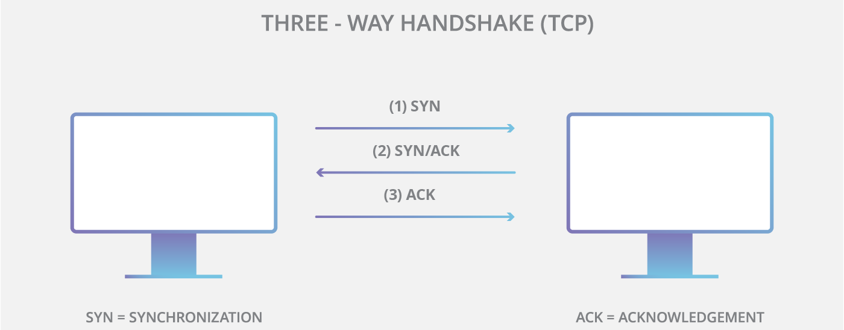
SYN Flood Attack
SYN flood attacks work by exploiting the handshake process of a TCP connection. Under normal conditions, TCP connection exhibits three distinct processes in order to make a connection.
First, the client sends a SYN packet to the server in order to initiate the connection.
The server then responds to that initial packet with a SYN/ACK packet, in order to acknowledge the communication.
Finally, the client returns an ACK packet to acknowledge the receipt of the packet from the server. After completing this sequence of packet sending and receiving, the TCP connection is open and able to send and receive data.

Slide 19
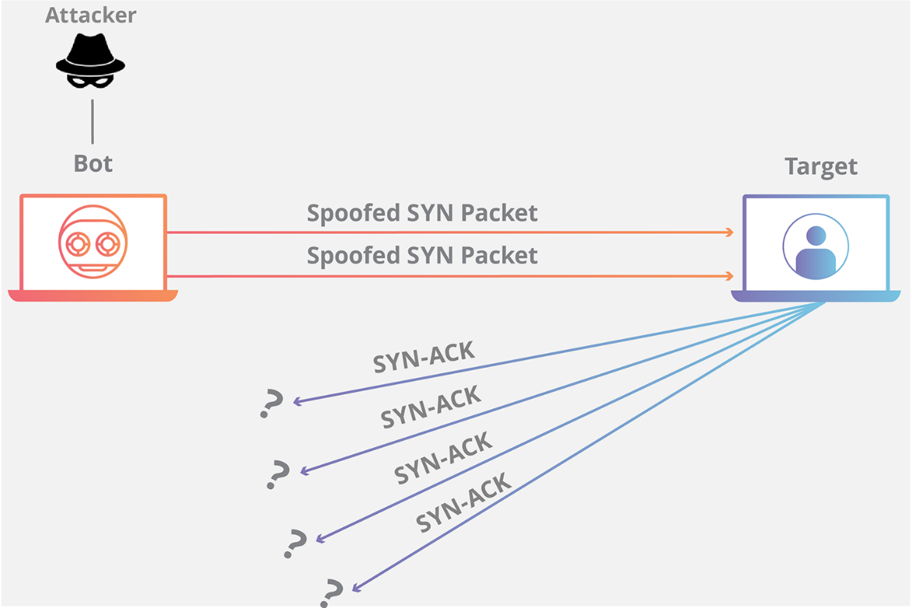
SYN Flood Attack
To create denial-of-service, an attacker exploits the fact that after an initial SYN packet has been received, the server will respond back with one or more SYN/ACK packets and wait for the final step in the handshake.

Slide 20
SYN Flood Attack
When a server is leaving a connection open but the machine on the other side of the connection is not, the connection is considered half-open.
In this type of DoS attack, the targeted server is continuously leaving open connections and waiting for each connection to timeout before the ports become available again.
The result is that this type of attack can be considered a “half-open attack”.

Slide 21
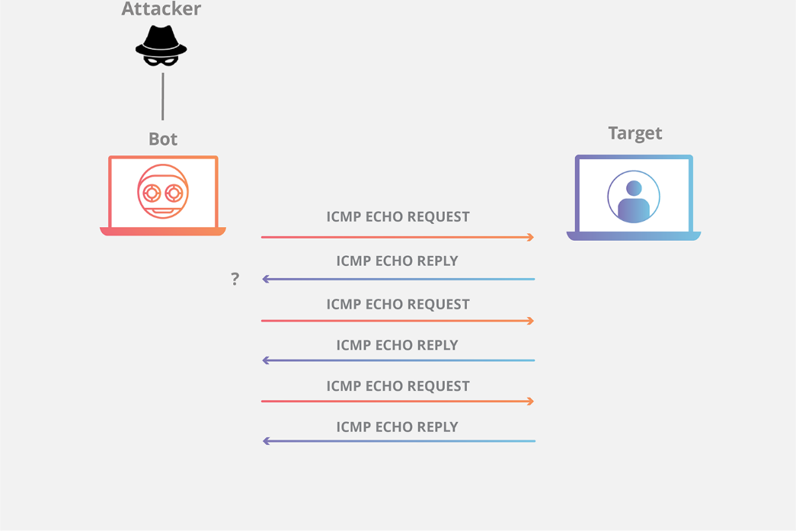
Ping Flood
A ping flood attack floods a victim with ping requests. This can be very effective when launched by zombies within a botnet as a DDoS attack.
If tens of thousands of systems simultaneously send ping requests to a system, the system can be overwhelmed trying to answer the ping requests.
A common way that systems handle this today is by blocking ICMP traffic.
Active intrusion detection systems can detect a ping flood and modify the environment to block ICMP traffic during the attack.

Slide 22
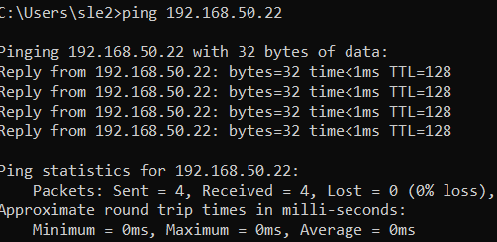
Ping of Death
A ping-of-death attack employs an oversized ping packet.
Ping packets are normally 32 or 64 bytes, though different operating systems can use other sizes.
The ping-of-death attack changed the size of ping packets to over 64 KB, which was bigger than many systems could handle.

Slide 23
Mitigation Techniques for DDoS
Mitigation of DoS/DDoS attacks can be achieved with multi-level protection strategies in place.
This includes advanced intrusion prevention and threat management systems, which combine firewalls, VPN, anti-spam, content filtering, load balancing, and other layers of DDoS defense techniques.
In addition to this, the systems should be always up-to-date. Outdated systems are usually the ones with most loopholes.

Slide 24
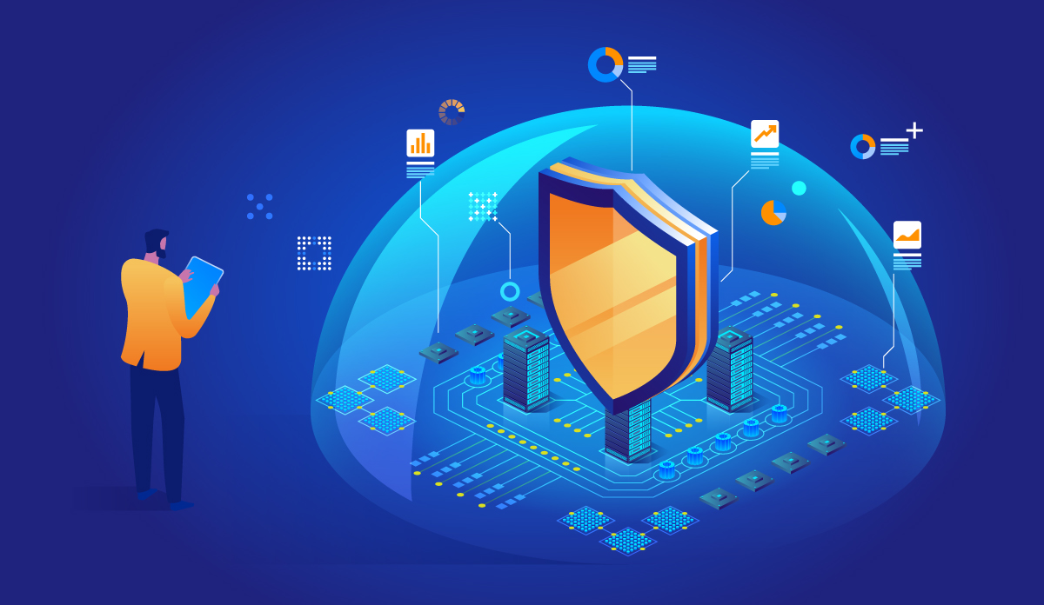
Defense-in-Depth

Slide 25
Defense-in-Depth
Layered security is typically seen as the best protection for systems security because it provides defense in depth.
The idea is that to fully compromise a system, the attacker must get past multiple security controls, providing control diversity.
These layers reduce the potential attack surface and make it much more likely that an attack will be prevented (or at least detected and then prevented by manual intervention).

Slide 26
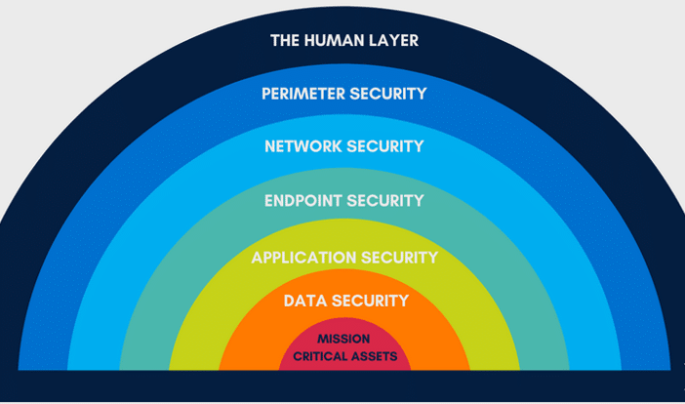
The Layered Security
Security Awareness Training
Firewall, IDS/IPS, Honeypot
Logging &
Monitoring
Secure Network Design &
Segmentation
(To be covered in Week 7)
(To be covered in Week 2)
Hardening
(To be covered in Week 2)
Patching, Updates,
Secure Development
Encryption
(To be covered in Week 6)

Slide 27
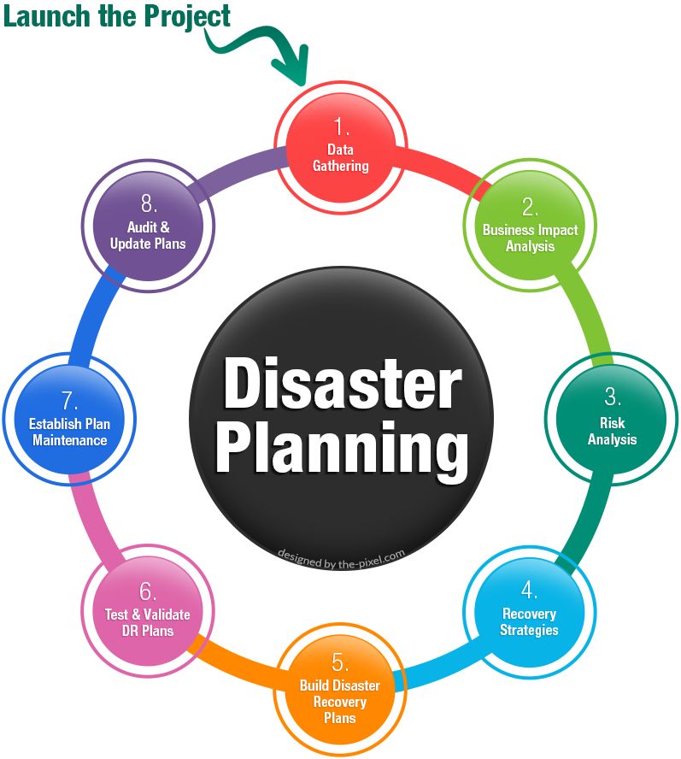
Disaster Recovery

Slide 28
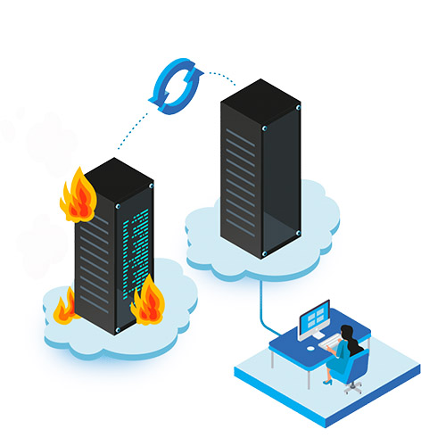
Disaster Recovery
IT systems in any company can go down unexpectedly due to unforeseen circumstances, such as power outages, natural events, or security issues.
Disaster recovery includes a company's procedures and policies to recover quickly from such events.

Slide 29
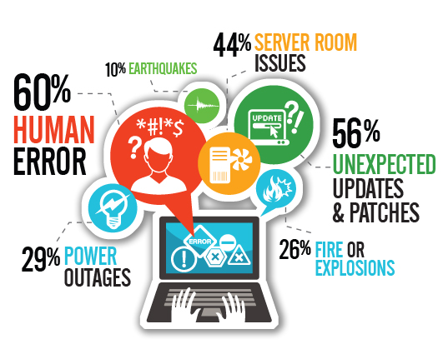
Disaster Recovery
A disaster is an unexpected problem resulting in a slowdown, interruption, or network outage in an IT system. Outages come in many forms, including the following examples:
An earthquake or fire
Technology failures
System incompatibilities
Simple human error
Cyber attacks such as malware, DDoS and ransomware attacks

Slide 30
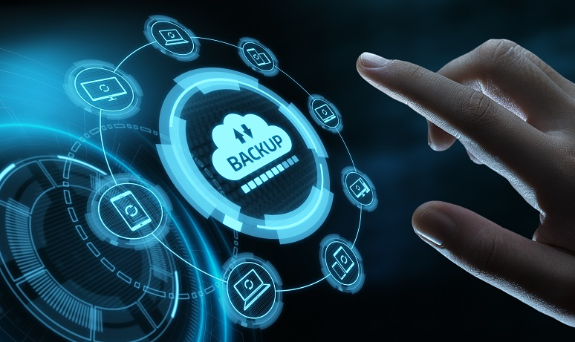
Disaster Recovery Plan
An organization sensitive to the risks of disasters will develop an effective, documented Disaster Recovery Plan (DRP).
Identify scenarios for natural and non-natural disaster and options for protecting systems.
Identify tasks, resources, and responsibilities for responding to a disaster.
Train staff in the disaster planning procedures and how to react well to change.

Slide 31
Backup Types
DR planning makes use of backups. A backup is made for security - it is a second (or third or fourth) copy of data made with the intention of being able to restore the original should it be lost or damaged.
The following table summarizes the three different backup types:
Type | Data Selection | Backup Time | Restore Time
Full | All selected data regardless of when it was previously backed up | High | Low
Incremental | New files and files modified since last backup | Low | High
Differential | All data modified since the last full backup | Moderate | Moderate

Slide 32
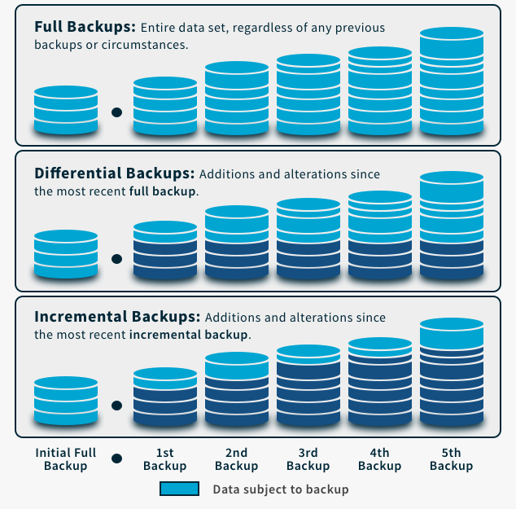
Backup Types
Recovery Steps
Only need to take the latest full backup in order to recover all the data.
Take the initial full backup;
Take the latest differential backup;
Combine the above to recover all the data.
Take the initial full backup;
Take each set of incremental backup after the initial full backup;
Combine the above to recover all the data.

Slide 33
Summary
Server Roles
Server Attack Vectors
Defense-in-Depth
Disaster Recovery

